Slide 1
Digital Image Processing Technologies & Applications
Color Image Processing

Slide 2
Contents
Full-color processing
Color transformations
Smoothing and sharpening
Color segmentation
Noise in Color Image

Slide 3
Full Color Image Processing
A full color image has a vector at each pixel. For colour images, these vectors each have 3 or 4 components.
There are two Categories to process vectorial images:
First Category
Process each component image individually
Form a composite processed color image
Second Category
Work with color pixel directly
Color pixels are vectors

Slide 4
Full Color Image Processing
Each channel is processed separately:
Red
Red
Scalar process.
Green
Green
Scalar process.
Blue
Blue
Scalar process.

Slide 5
Full Color Image Processing
The colour triplets are processed as single units:
Red
Red
Green
Green
Vectorial process.
Blue
Blue

Slide 6
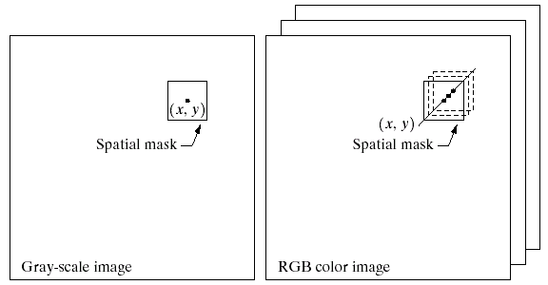
Full Color Image Processing
In order for per-color-component and vector based processing to be equivalent:
（1）The process has to be applicable to both vectors and scalars
（2）The operation on each component of a vector must be independent of other components.
For example：
Neighborhood averaging
Per-color-component processing = Vector based processing

Slide 7
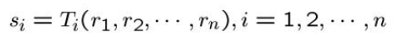

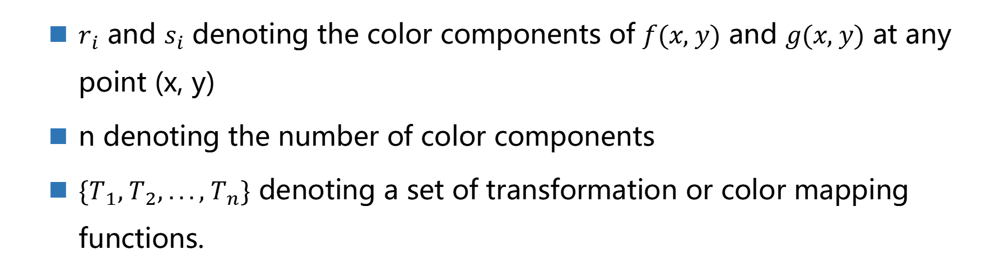
Color Transformation
$$g(x, y)=T[f(x, y)]$$
Different with gray level: pixel values are triplets or quartets.
$$s_{i}=T_{i}(r_{1},r_{2}, ...,r_{n}), i=1, 2, ..., n$$
$r_{i}$ and $s_{i}$ denoting the color components of $f(x, y)$ and $g(x, y)$ at any point (x, y)
n denoting the number of color components
$\{T_{1}, T_{2}, ..., T_{n}\}$ denoting a set of transformation or color mapping functions.

Slide 8
Color Transformation
For example:
RGB color space
– n=3, r₁,r₂, r₃ denote the red, green, blue
CMYK or HSI space are chosen
– n=4 or n=3

Slide 9
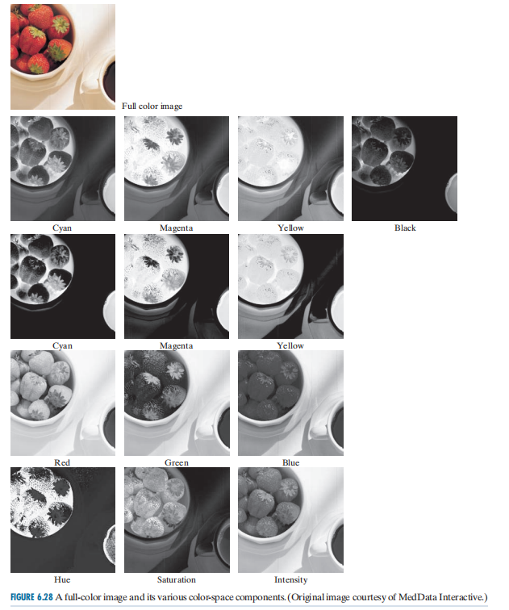
Colo Transformation

Slide 10
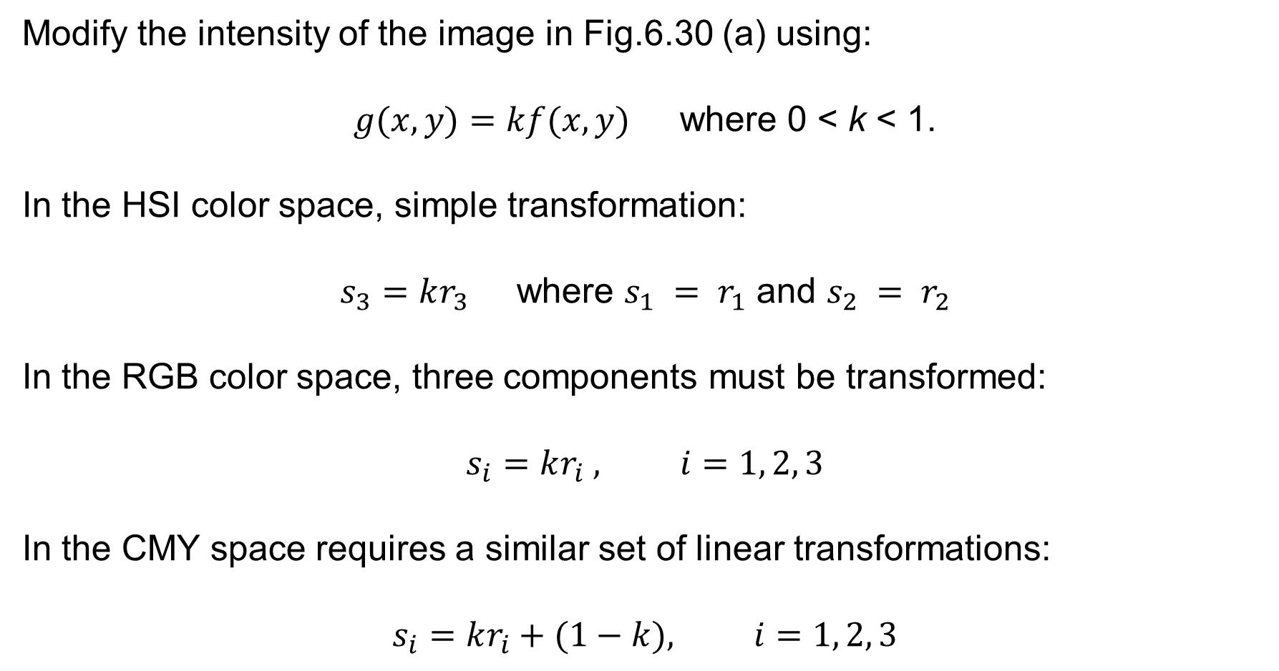
Color Transformation
Modify the intensity of the image in Fig.6.30 (a) using:
$g(x, y)=kf(x, y)$ where 0 < k < 1.
In the HSI color space, simple transformation:
$s_{3}=kr_{3}$ where $s_{1} = r_{1}$ and $s_{2} = r_{2}$
In the RGB color space, three components must be transformed:
$$s_{i}=kr_{i} , i=1, 2, 3$$
In the CMY space requires a similar set of linear transformations:
$$s_{i}=kr_{i}+(1−k), i=1, 2, 3$$

Slide 11
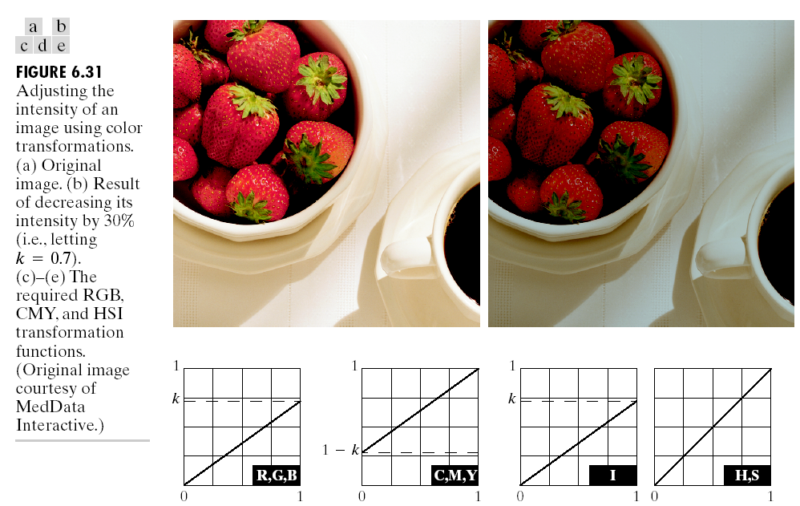
Color Transformation
S_{i}=kr_{i}
S_{i}=k r_{i} +1-k
S₃=kr₃=k*I

Slide 12
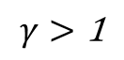
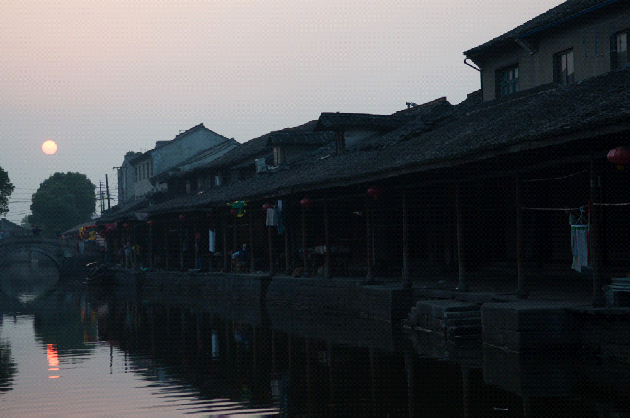
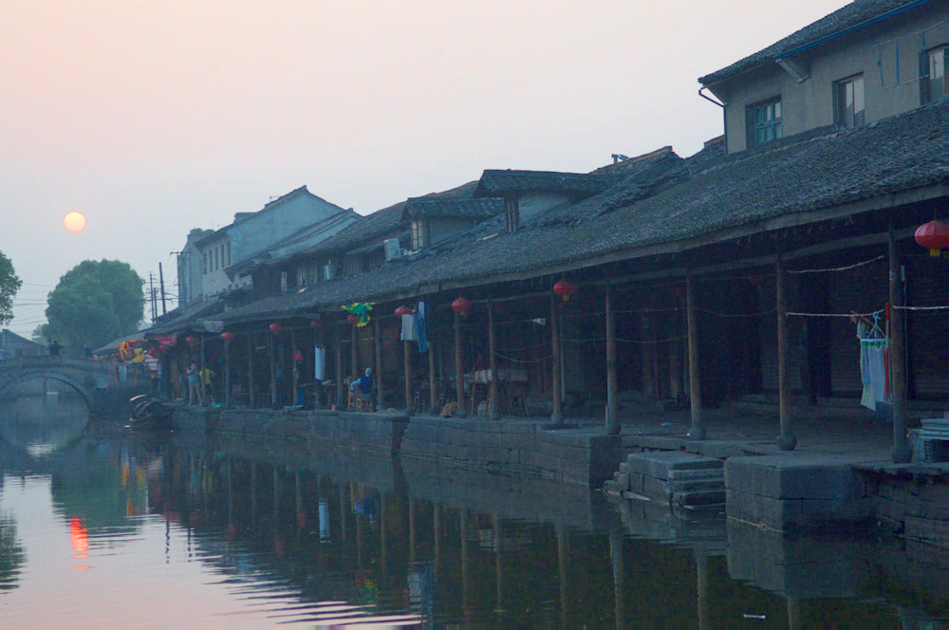
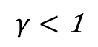
Color Transformation
亮度增强：伽马校正
HSI Space, I Component:
Notes:
Hue，而不是灰度图像的反色。

Slide 13
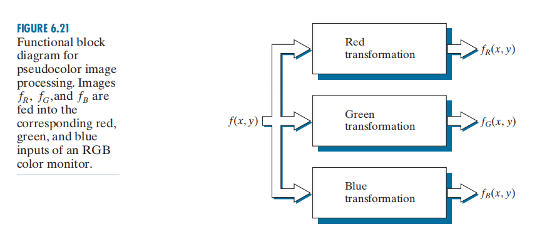
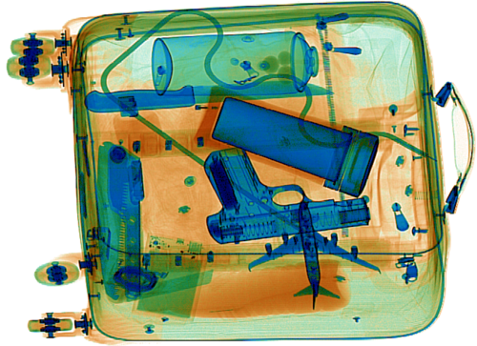
Color Transformation
Notes:
Hue，而不是灰度图像的反色。

Slide 14
Color Transformation
Function EnhanceIntensity()
I = imread('..\data\exposure1.jpg');
gamma = 3;
% gamma = 0.5;
I = im2double(I);
hsv = rgb2hsv(I);
hsv(:,:,3) = hsv(:,:,3).^gamma;
J = hsv2rgb(hsv);
figure(1), clf
subplot(1,2,1),imshow(I);
subplot(1,2,2),imshow(J);

Slide 15
Color Transformation
Remarks
Any transformation can be performed in any color model
Actually, some operations are better suited to specific models.
HSI transformation involves the fewest number of operations.
But the computations required to convert an RGB or CMYK image to HSI space more than offsets the advantages of the simpler transformation.
Regardless of the color space selected, the output is the same.

Slide 16
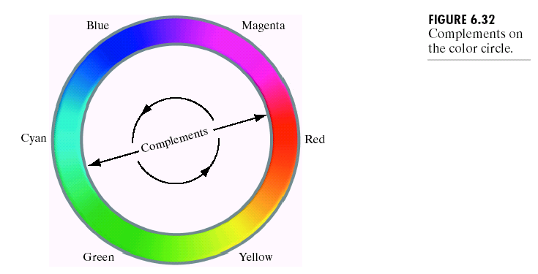
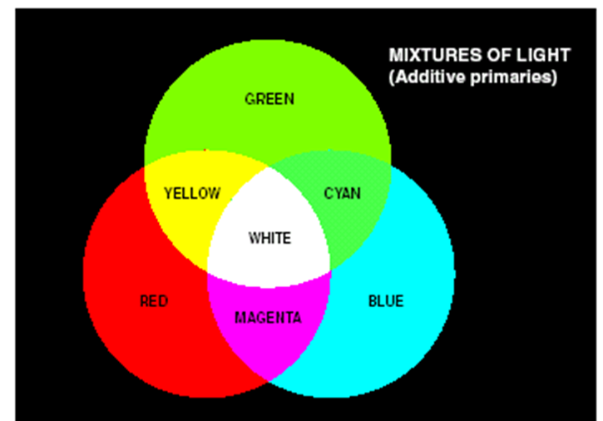
Color Complements
Same as gray level negative.
Color complements are useful for enhancing detail that is embedded in dark regions of a color image.

Slide 17
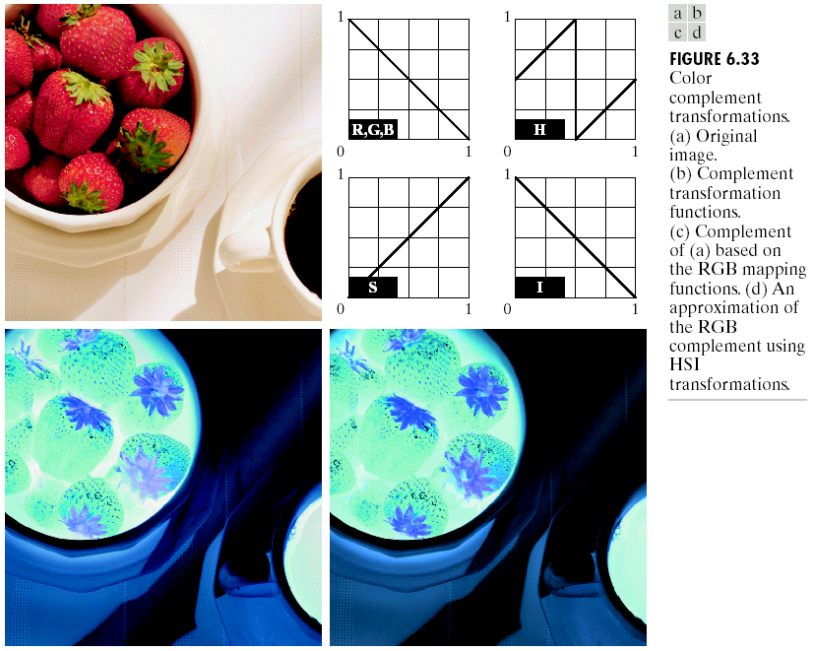
Color Complements
Note: have no corresponding functions in HSI space in color complements.

Slide 18
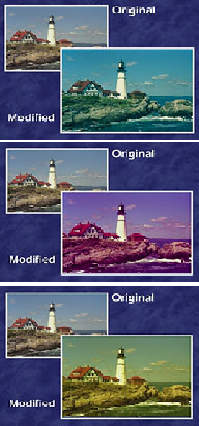
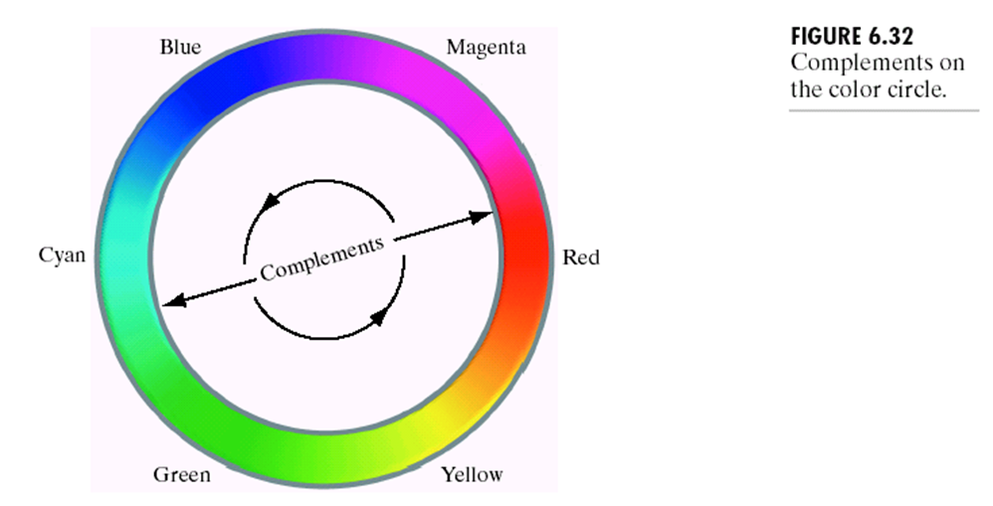
Color Complements
Reducing the red color plane by 50 levels moves the color balance towards cyan.
Reducing the green color plane by 50 levels moves the color balance towards magenta.
Reducing the blue color plane by 50 levels moves the color balance towards yellow

Slide 19
Color Slicing
Highlighting a specific range of colors.
Separating objects from their surrounds.
Basic idea:
Display the colors of interest.
Use the regions defined by the colors as a mask for further processing.
More complicated than gray-level counterparts.
Require each pixel’s transformed color components to be a function of all n original pixel’s color components.

Slide 20
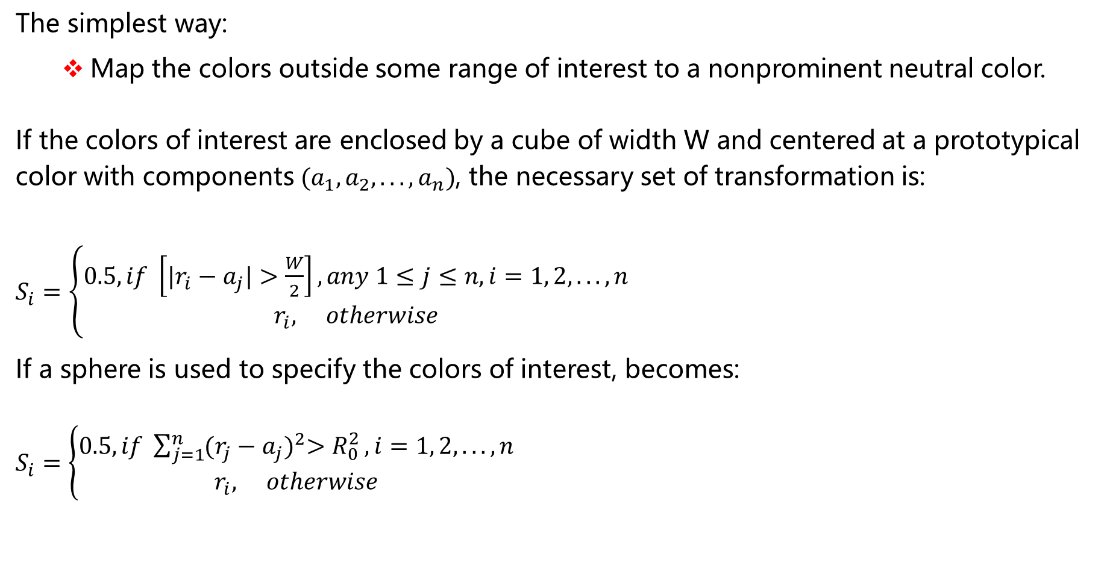
Color Slicing
The simplest way:
Map the colors outside some range of interest to a nonprominent neutral color.
If the colors of interest are enclosed by a cube of width W and centered at a prototypical color with components $(a_{1}, a_{2}, ..., a_{n})$, the necessary set of transformation is:
$S_{i}=\left\{\begin{aligned}0.5, if \left[|r_{i}−a_{j}|>\frac{W}{2}\right],any 1≤j≤n, i=1, 2, ..., n \\ r_{i}, otherwise\end{aligned}\right.$
If a sphere is used to specify the colors of interest, becomes:
$S_{i}=\left\{\begin{aligned}0.5, if \sum_{j=1}^{n}{{(r_{j}−a_{j})}^{2}>R_{0}^{2}}, i=1, 2, ..., n \\ r_{i}, otherwise\end{aligned}\right.$

Slide 21
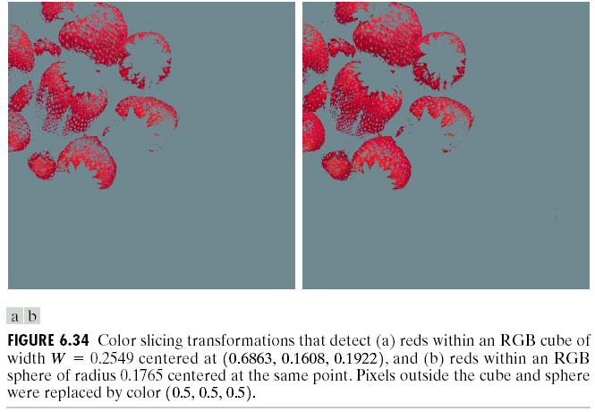
Color Slicing

Slide 22
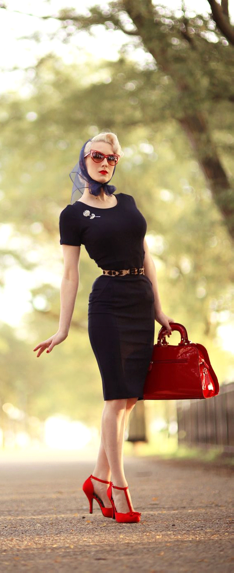
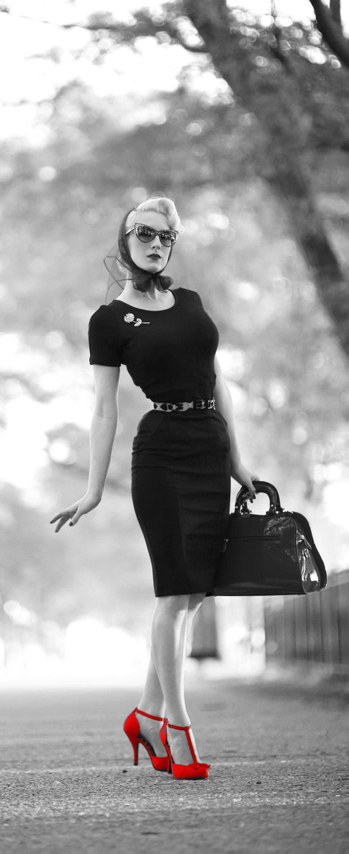
Color Slicing

Slide 23

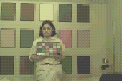
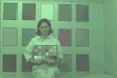
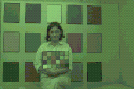
Tone and Color Corrections
Most Common Uses
Photo enhancement.
Color reproduction.
Consistent: since these transformations are developed, refined, and evaluated on monitors, it is necessary to maintain high color consistency between monitor and output devices.

Slide 24
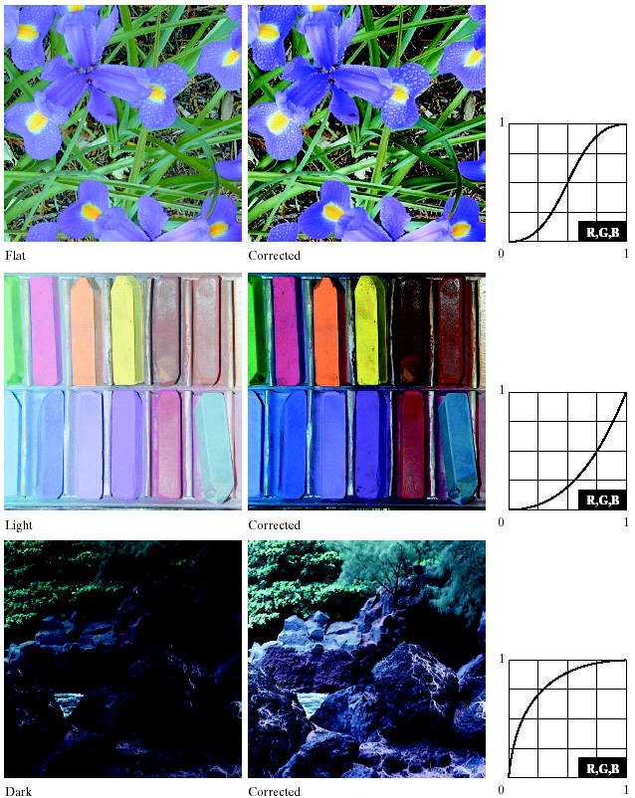
Tone and Color Corrections
The principle of calibrated imaging systems is that they allow intensity and color imbalances to be corrected interactively and independently.
That is, in two sequential operations.
<=Intensity corrections

Slide 25
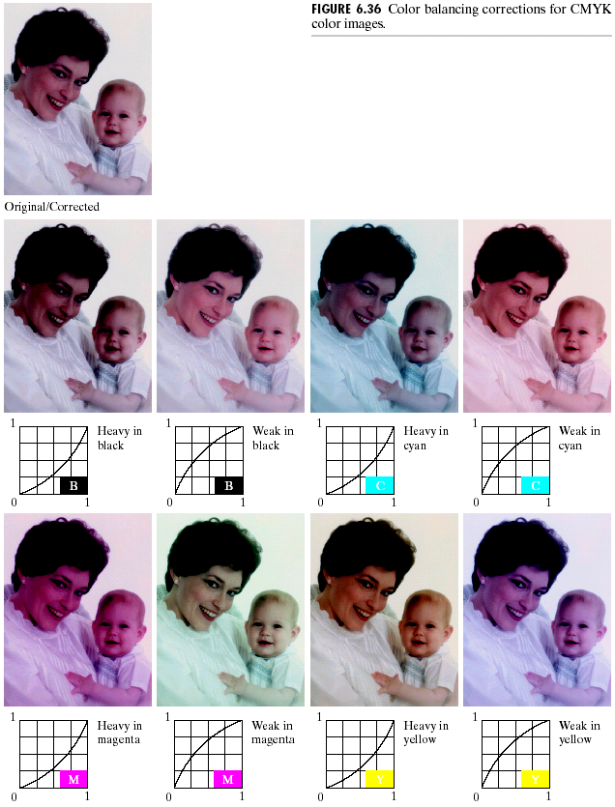
Color Corrections
Notes: every action affects the overall color balance of the image. That is the perception of one color is affected by its surrounding colors.

Slide 26
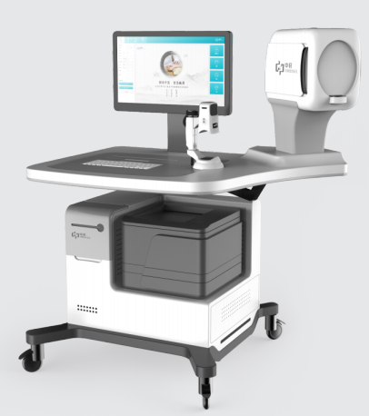
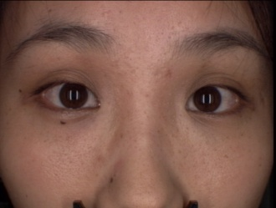
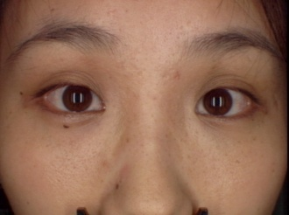
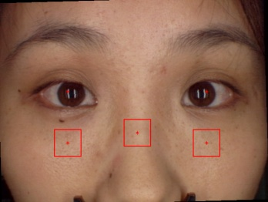
Tone and Color Corrections
Application Examples: Face and tongue diagnosis
Image capture
Color Correction
Segmentation
Feature Extraction
Results!
Classification
Data Base

Slide 27
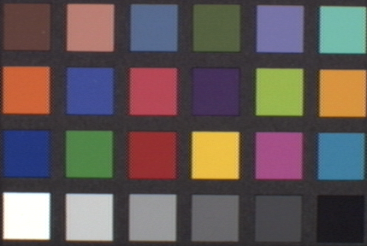
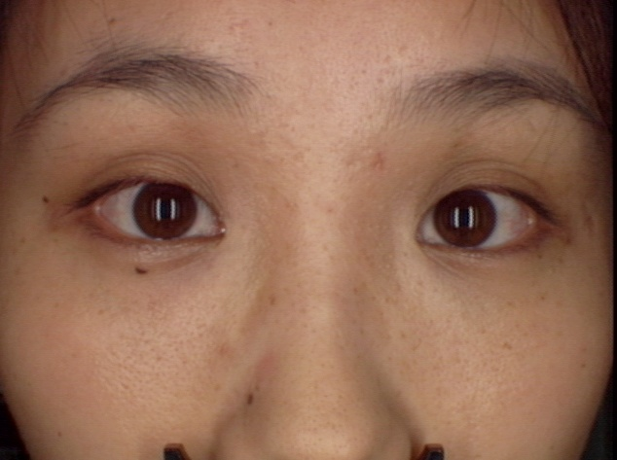
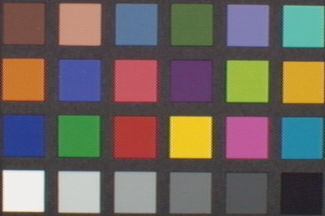
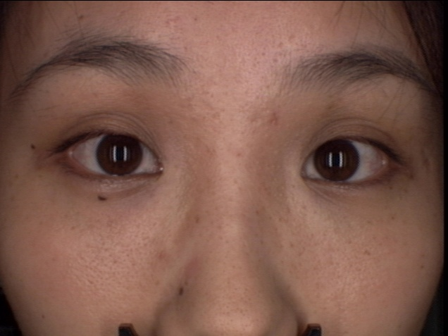
Tone and Color Corrections
Correction
Model

Slide 28
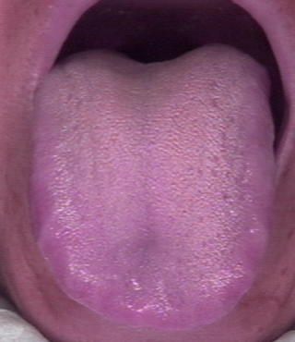
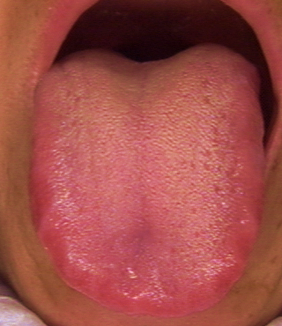
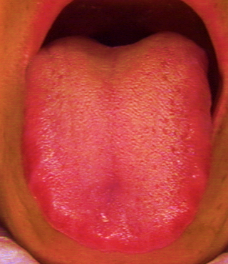
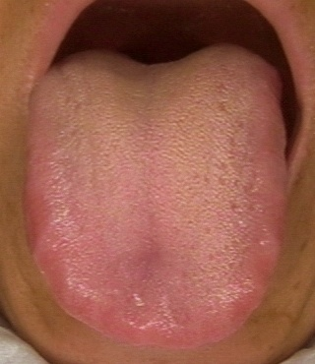
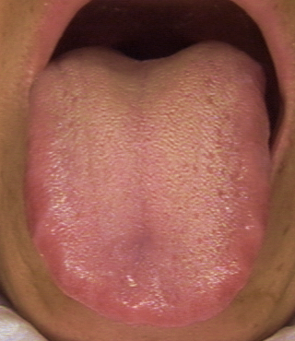
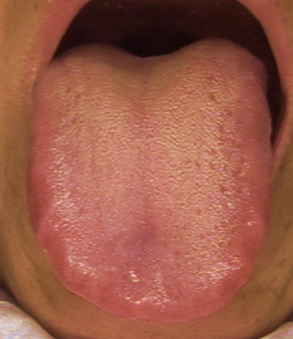
Tone and Color Corrections
Before
correction
After correction

Slide 29
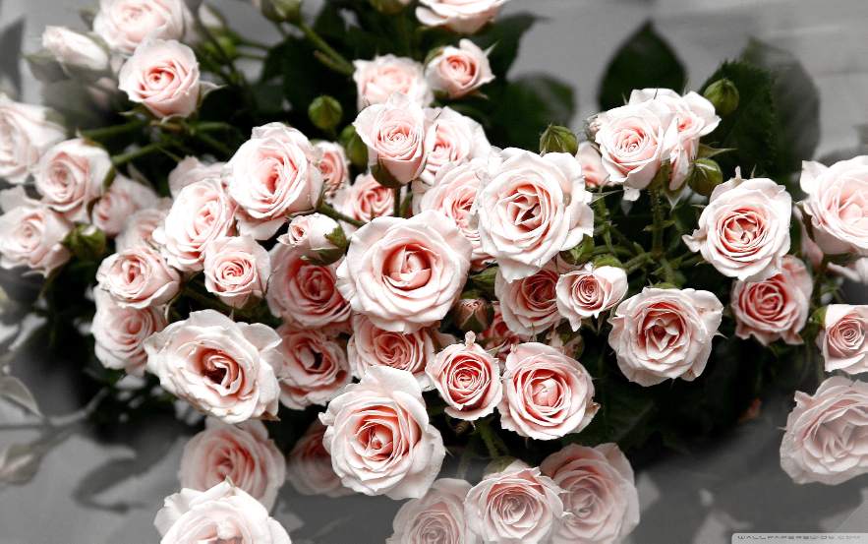
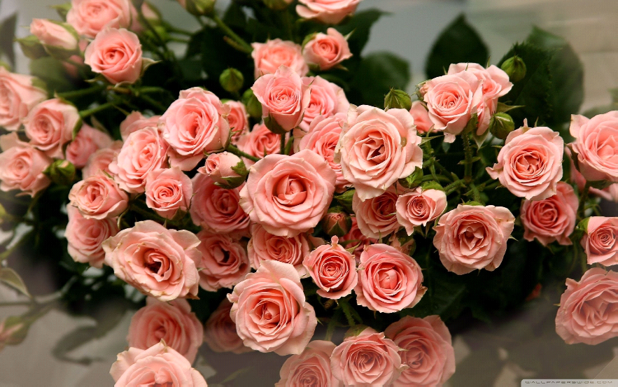
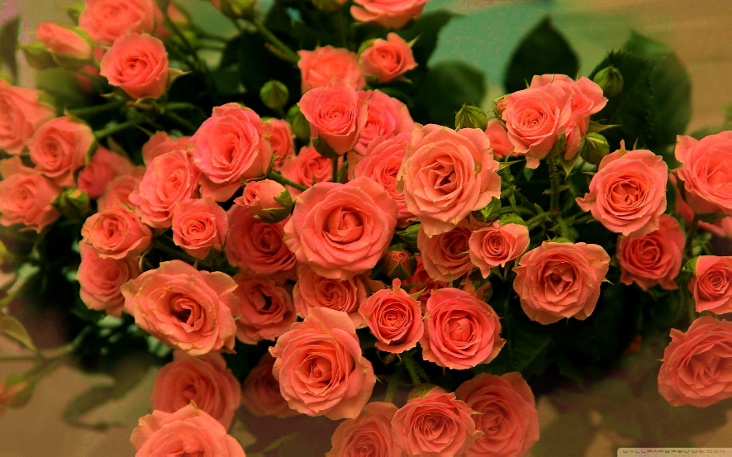
Saturation Enhancement
减小饱和度，图像颜色变淡，原来比较淡的区域已经变为灰色
增加饱和度，图像颜色变艳
减小
增加
Notes:
Hue，而不是灰度图像的反色。

Slide 30
Saturation Enhancement
function EnhanceSaturation()
I = imread('..\data\saturation2.jpeg');
% I = imread('..\data\saturation3.jpg');
I = im2double(I);
hsv = rgb2hsv(I);
hsv2 = hsv;
gamma = 3;
hsv2(:,:,2) = hsv(:,:,2).^gamma;
J1 = hsv2rgb(hsv2);
gamma = 0.3;
hsv2(:,:,2) = hsv(:,:,2).^gamma;
J2 = hsv2rgb(hsv2);
figure(1), clf
subplot(1,3,1),imshow(I);
subplot(1,3,2),imshow(J1);
subplot(1,3,3),imshow(J2);
Notes:
上课时，增加显示S分量图像的代码。

Slide 31
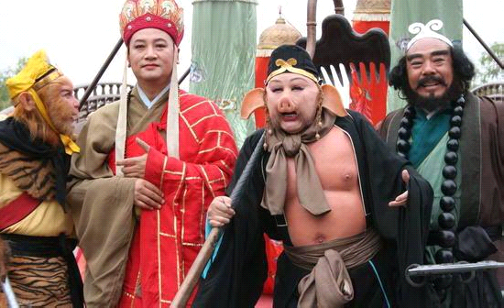
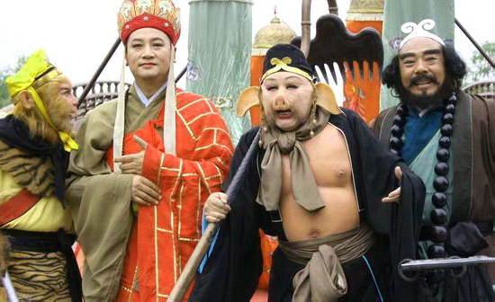
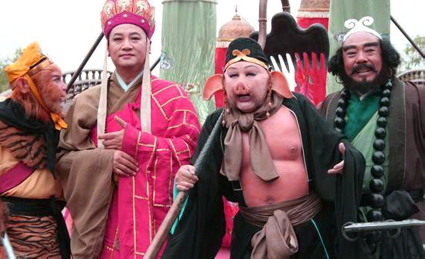
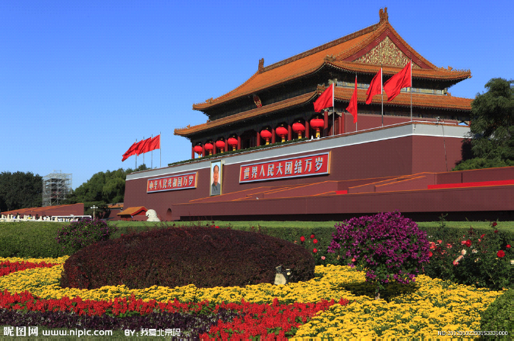
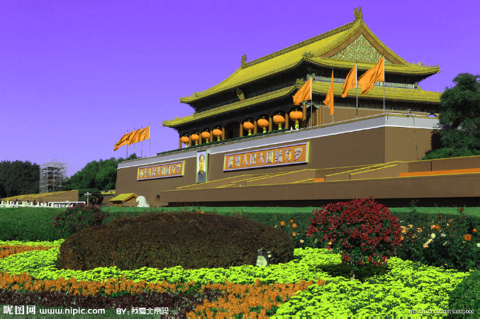
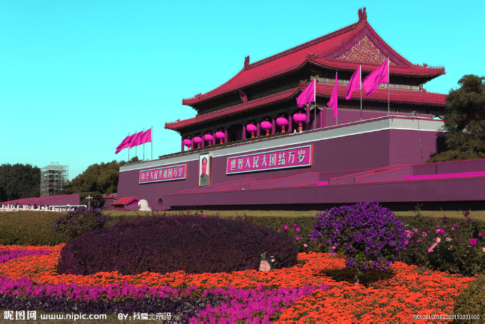
Hue Enhancement
与亮度、饱和度的增强相比，色调增强比较特殊。
在HSI空间中，色调对应的是角度，而且是循环的。
如果色调整体加或减一个数，颜色在色谱上移动。当数字比较小时，色调变冷或暖；当数字较大时，色调会出现剧烈变化。
+0.05
-0.05
+0.1
-0.1
Notes:
与亮度、饱和度的增强相比，色调增强比较特殊。在HSI空间中，色调对应的是角度，而且是循环的。如果色调整体加一个数，那么颜色在色谱上移动。当数字比较小的时候，图像的色调变冷，否则变暖。

Slide 32
Hue Enhancement
function EnhanceHue()
I =imread('..\data\Fig0636(woman_baby_original).tif');
% I = imread('..\data\saturation3.jpg');
I = im2double(I);
hsv = rgb2hsv(I);
hsv2 = hsv;
hsv2(:,:,1) = mod(255*(hsv(:,:,1)+0.05),256)/255;
J1 = hsv2rgb(hsv2);
hsv2(:,:,1) = mod(255*(hsv(:,:,1)-0.05),256)/255;
J2 = hsv2rgb(hsv2);
close all
figure(1)
subplot(1,3,1),imshow(I);
subplot(1,3,2),imshow(J1);
subplot(1,3,3),imshow(J2);

Slide 33
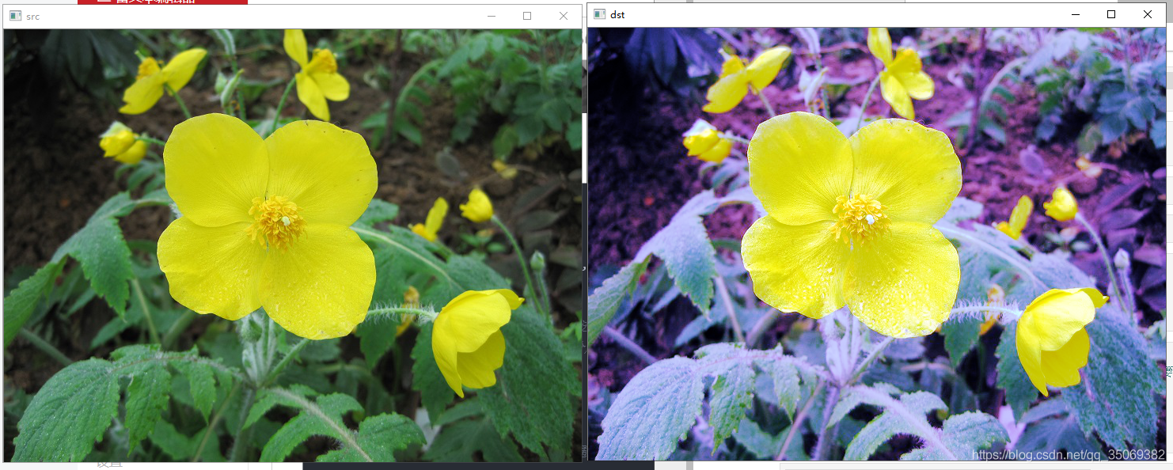
Histogram Processing
Automated way, and very efficient in Gray image processing.
Unwise to histogram equalize the components of a color image independently.
Lead to erroneous color.
A more logical approach
Spread the color intensities uniformly.
Leaving the colors themselves (e.g Hue) unchanged.

Slide 34

Histogram Processing

Slide 35



Histogram Processing
RGB
HSI
Notes:
对比两个颜色空间做直方图均衡的区别。RGB出现色调上的变化。HSI没有。

Slide 36
Histogram Processing
function ColorHistEq()
% ColorHistEq
% 2016-11-05
I = imread('..\data\color_histeq2.jpg');
I = im2double(I);
J1 = I;
for k = 1:3
J1(:,:,k) = histeq(I(:,:,k));
end
I_hsv = rgb2hsv(I);
J2_hsv = I_hsv;
J2_hsv(:,:,3) = histeq(I_hsv(:,:,3));
J2 = hsv2rgb(J2_hsv);
close all
figure(1),imshow(I)
figure(2),imshow(J1)
figure(3),imshow(J2)
figure(4),subplot(2,1,1),imhist(I_hsv(:,:,3)),title('before histeq')
figure(4),subplot(2,1,2),imhist(J2_hsv(:,:,3)),title('after histeq')
figure(5),clf
for k = 1:3
ax(1)=subplot(3,3,k);imhist(I(:,:,k));
ax(2)=subplot(3,3,k+3);imhist(J1(:,:,k));
ax(3)=subplot(3,3,k+6);imhist(J2(:,:,k));
end

Slide 37
Smoothing and Sharpening
Modify value based on the characteristics of the surrounding pixels.
–Smoothing
–Sharpening
Color image smoothing
Gray image: Each pixel is replaced by the average of the pixels in the neighborhood defined by the mask.
Deal with component vectors.

Slide 38

Color Image Smoothing
Let $S_{xy}$ denote the set of coordinates defining a neighborhood centered at (x, y) in an RGB color images.
The average of the RGB component vectors in this neighborhood is
$$\overline{c}(x, y)=\frac{1}{K}\sum_{(x, y)∈S_{xy}}{c(x, y)}$$
The properties of vector addition that
$$\overline{c}(x, y)=\frac{1}{K}\left[{\sum_{(x, y)∈S_{xy}}{R_{xy}} \atop \begin{aligned}\sum_{(x, y)∈S_{xy}}{G_{xy}} \\ \sum_{(x, y)∈S_{xy}}{B_{xy}}\end{aligned}}\right]$$
Note: The results is the same when smoothing each plane of starting RBG image using conventional gray scale neighborhood processing.

Slide 39


Color Image Smoothing
Filtered by 5*5 averaging mask

Slide 40

Color Image Smoothing
Smoothing intensity component only

Slide 41
Color Image Smoothing
function ColorSmooth()
% ColorSmooth
% 2016-11-05
I = imread('..\data\Fig0638(a)(lenna_RGB).tif');
I = im2double(I);
hsize = 31;% size of averaging filter
h = ones(hsize,hsize)/(hsize*hsize);
J1 = I;
for k = 1:3
J1(:,:,k) = imfilter(I(:,:,k),h);
end
I_hsv = rgb2hsv(I);
J2_hsv = I_hsv;
J2_hsv(:,:,3) = imfilter(I_hsv(:,:,3),h);
J2 = hsv2rgb(J2_hsv);
close all
for k = 1:3
figure(1),subplot(1,3,k),imshow(I(:,:,k))
figure(2),subplot(1,3,k),imshow(I_hsv(:,:,k))
figure(3),subplot(1,3,k),imshow(J1(:,:,k))
figure(4),subplot(1,3,k),imshow(J2(:,:,k))
figure(5),subplot(1,3,k),imshow(J2_hsv(:,:,k))
end
set(1,'name','I')
set(2,'name','I_hsv')
set(3,'name','J1')
set(4,'name','J2')
set(5,'name','J2_hsv')
figure(6),subplot(1,3,1),imshow(I),title('I')
subplot(1,3,2),imshow(J1),title('J1: smooth RGB channels')
subplot(1,3,3),imshow(J2),title('J2: smooth intensity of HSI only')

Slide 42
Color Image Smoothing
Original Image

Slide 43


Color Image Smoothing
RGB smoothing
I smoothing
HSI smoothing
Wrong!

Slide 44

Color Image Smoothing

Slide 45
Color Image Smoothing
M=imread('flower.jpg');
subplot(2,2,1)
imshow(M) %显示原始图像
title('original')
P1=imnoise(M,‘salt & pepper’,0.02); %加入椒盐躁声
subplot(2,2,2)
imshow(P1) %加入高斯躁声后显示图像
title('salt & pepper noise');
g1=medfilt2(P1(:,:,1));%%红
g2=medfilt2(P1(:,:,2));%%绿
g3=medfilt2(P1(:,:,3));%%蓝
g(:,:,1)=g1;
g(:,:,2)=g2;
g(:,:,3)=g3;
subplot(2,2,3)
imshow(g)
title('medfilter salt & pepper');

Slide 46

Color Image Sharpen
In the RGB color system, the Laplacian of vector c is

Slide 47

Color Image Sharpen
Sharpening in RGB
Sharpening in HSI-Intensity
0
-1
0
-1
5
-1
0
-1
0

Slide 48

Color Image Segmentation
图像分割是计算机视觉研究中的一个经典难题，是图像分析的第一步，是图像理解的重要组成部分，同时也是图像处理中最困难的问题之一。
图像分割：对图像的像素级描述，包括语义分割、实例分割、全景分割。
语义分割
实例分割
全景分割
Notes:
语义分割就是把图像中每个像素赋予一个类别标签（比如汽车、建筑、地面、天空等），比如上图就把图像分为了行人（红色）、车辆（蓝色）、树木（绿色）、信号灯（黄色）等标签，用不同的颜色来表示。
实例分割不需要对每个像素进行标记，目标是找到感兴趣物体的边缘轮廓，以区分出单个个体。
全景分割，它是语义分割和实例分割的结合，每个像素都被分为一类，如果一种类别里有多个实例，会用不同的颜色进行区分，我们可以知道哪个像素属于哪个类中的哪个实例

Slide 49

Color Image Segmentation
Segmentation: Partition an image into regions
Segmentation in HSI Color Space
Segmentation in RGB Vector Space

Slide 50
Segmentation in HSI Space
Segment an image based on color in HSI space:
Color is conveniently represent in the hue image.
Saturation is used as a masking image in order to isolate further regions of interest in the hue image.
Intensity infrequently used for segmentation, Since it carries no color information.

Slide 51


Segmentation in HSI Space
H
S
I

Slide 52
Segmentation in HSI Space
Segmentation in RGB Space
HSI Space: more intuitive.
RGB: better results.
Objective: Segment objects of a specified color range in an RGB image.
Given a set of sample color points representative of the colors of interest.
An estimate of the “average”color that we wish to segment.

Slide 53


Segmentation in HSI Space
Let the average color be denoted by the RGB vector a.
Similarity-measure:
Identify a color in the specified range or not.
Euclidean distance.

Slide 54

Segmentation in HSI Space
Generalization:
Where C is the covariance matrix of the samples representative of the color we wish to segment. When C=I, it is as the described in the preceding page.

Slide 55
Segmentation in HSI Space
However, implementing of last two methods is computationally expensive for images of practical size, even if the square roots are not computed.
A compromise is to use a bounding box.
Given an arbitrary color point, we segment it by determining whether or not it is on the surface or inside the box.

Slide 56

Segmentation in HSI Space
Select sample by rectangular region
compute its mean vector a，
Compute standard deviation σ_{r}，σ_{g}， σ_{b}
Get box:
（a_{r}- 1.25σ_{r}）~ （a_{r}+ 1.25 σ_{r}）
（a_{g}- 1.25 σ_{g}）~ （a_{g}+ 1.25 σ_{g}）
（a_{b}- 1.25 σ_{b}）~ （a_{b}+ 1.25 σ_{b}）
Coding：1—in the box
0---else

Slide 57
Segmentation in HSI Space
Segmentation results in HSI space
Segmentation results in RGB space

Slide 58

Noise in Color Images
Take a brief look at noise in color images and how noise carries over when converting from one color model to another.
Noise is fine grain noise such as this tends to be less visually noticeable in a color image than it is in a monochrome image.

Slide 59

Noise in Color Images
HSI
No noise
绿色分量被噪声污染
HSI
With noise

Slide 60

Noise in Color Images
Note:
Hue and saturation components of noisy image are significantly degraded.
This is due to the nonlinearity of the cos and min operations in the RGB to HSI transformation
On the other hand, the intensity component is slightly smoother than any to the three noisy RGB component images.
Regarding the fact that image averaging reduces random noise.

Slide 61

Noise in Color Images

Slide 62
Summary
In this lecture we have learned:
Color Fundaments
Color Model
Pseudo-color processing
Full-color transformation
Smoothing and Sharpening
Color Slicing
Noise in color images
Next we will look at Representation & Description

